Slide 1

Computer and Laptop Management System
Submitted By: Asad MEHMOOD 2020-CS-10
Submitted To: Ms. Maida Shahid

Slide 2
Abstract:
In this program, there will be three users.
1. Admin.
2. Employee.
3. Customer.
Admin can add employees, delete employee, view the employees and view the available stock.
Employee can add items category wise. There are two categories: “Computer” and “Laptop”. Employee can view all the added products, change the prices of products, sort the products in descending order and change the password of their account.
Customer can view the available stock, place the order and pay the bill.

Slide 3
Functional Requirement:
There are three type of users:
Admin
Employee
Customer

Slide 4
For Admin:
As a admin, I can add employees.
As a admin, I can view employees.
As a admin. I can delete employees.
As a admin, I can view the available stock.

Slide 5
For Employee:
As a employee, I can add items category wise.
As a employee, I can view items category wise.
As a employee, I can change price of entered products.
As a employee, I can sort the products in descending order.
As a employee, I can change the password of account.

Slide 6
For Customer:
As a customer, I can view the available stock.
As a customer, I can place my order.
As a customer, I can pay the bill.

Slide 7
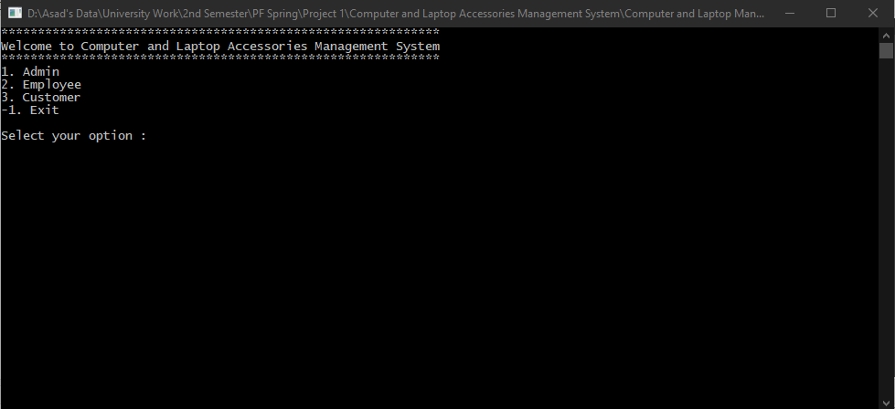
Wireframes:
Main Menu

Slide 8
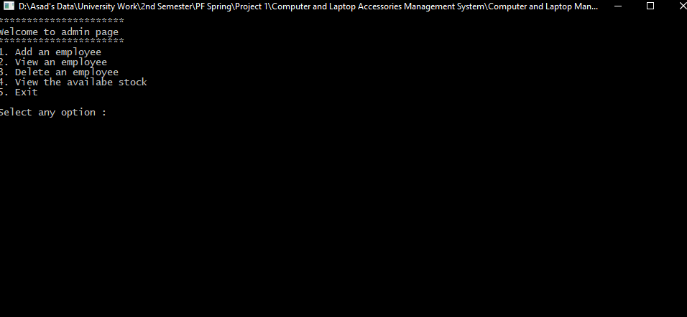
Admin:

Slide 9
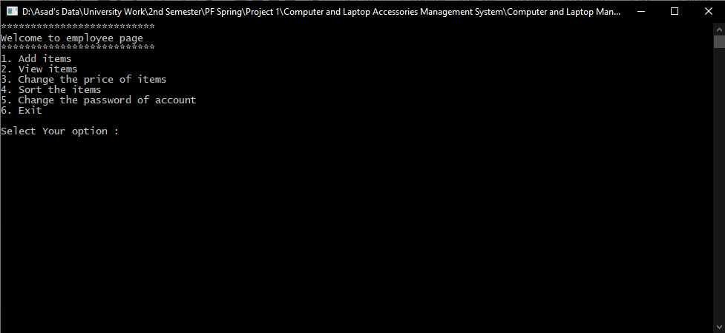
Employee:

Slide 10
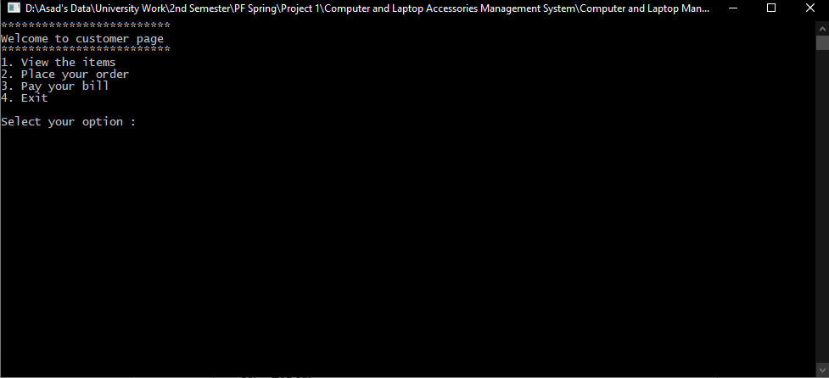
Customer:

Slide 11
Data Structures:
Arrays:
string employee_name[10];
string employee_pass[10];
string employee_cnic[10];
string computer_items[10];
int computer_price[10];
int computer_quantity[10];
string laptop_items[10];
int laptop_price[10];
int laptop_quantity[10];
string computerorder[10];
int computerquantity[10];
string laptoporder[10];
int laptopquantity[10];

Slide 12
Functions:
void main_menu();
void admin(int option);
void admin_welcome();
void add_employee();
void view_employee();
void delete_employee();
void view_stock();
void employee(int option);
void employee_welcome();
void add_items();
void view_items();
void price_change();
void sorting();
void password_change();

Slide 13
Functions:
void customer(int option);
void customer_welcome();
void place_the_order(string select);
void pay_the_bill();

Slide 14
Variables:
int i=0;
int q=0;
int r=0;
int t=0;
int a=0;
int s=0;
int id3=0;
int id5=0;
string select;
string computer_order_item;
string laptop_order_item;
int computer_order_quantity;
int laptop_order_quantity;

Slide 15
Function Header and Description:
void main_menu();
This Function will display the main menu.
void admin(int option);
This Function will call entire admin port
void admin_welcome();
This function will display admin welcome.
void add_employee();
This Function will be used to add employees.
void view_employee();
This function will be used to view all the added employees.
void delete_employee();
This function will be used to deleted employee.
void view_stock();
This function will display all the products added.

Slide 16
Function Header and Description:
void employee(int option);
This function will call entire employee portion.
void employee_welcome();
This function will display employee welcome.
void add_items();
This function will used to add products category wise.
void view_items();
This function will used to view products category wise.
void price_change();
This function will used to change the price of products.
void sorting();
This function will sort all the products in descending order.
void password_change();
This function will used to change the password of login account.

Slide 17
Function Header and Description:
void customer(int option);
This function will be used to call entire customer portion.
void customer_welcome();
This function will be used to display customer welcome.
void place_the_order(string select);
This function will be used to place order by customer.
void pay_the_bill();
This function will be used to pay the bill by customer.

Slide 18
Flowcharts:
Three Users
Admin
Employee
Customer

Slide 19
Admin
add_employee()
view_employee();
delete_employee();
view_stock();

Slide 20
Employee
add_items()
view_items();
change_price();
Sorting();
change_password();

Slide 21
Customer
view_stock()
place_the_order;
pay_the_bill();

Slide 22
Future Direction:
Admin will add online outlet.
Admin will add location or home delivery option.
Admin will add advance booking of products option.
Admin will add special discount on specific days (like Black Friday etc).
Employee will add category for new and used product.

Slide 23
Thank You.

